Slide 1


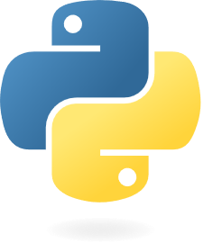

Lesson 03:
Data structures (lists, dictionary, tuple, set, range, generator)
Functions & modules
Mutable & immutable data types
Exceptions and error handling
Python for beginners
with applications
Write code from scratch in a clear & concise way, through a complete basic course.
From beginners to intermediate.
Abdesselam Filali 2025-12-03 19h00 Algiers time

Slide 2

1. Data strucyures 1.1. Lists 1.2. Tuples 1.3. Sets 1.4. Dictionnaries 1.5. ranges 1.6. Generators

Slide 3
2. Creating and using functions

Slide 4
Creating and using functions
Overview
A function is a block of code that performs a specific task when it is called, and functions are reusable, which means you can write a function once and use it as many times as you want.
Python has several built-in functions that you may be familiar with, including:
- print() prints an object to the terminal
- int() converts a string or number data type to an integer data type
- len() returns the length of an object
Function names include parentheses and may include parameter (arguments).
we’ll go over how to define your own functions to use in your coding projects

Slide 5

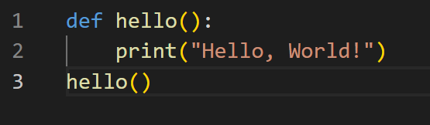
Creating and using functions
Defining a function
A function is defined by using the def keyword, followed by a name of your choosing, followed by a set of parentheses which hold any parameters the function will take (they can be empty), and ending with a colon.
Our function is now fully defined, but if we run the program at this point, nothing will happen since we didn’t call the function.

Slide 6
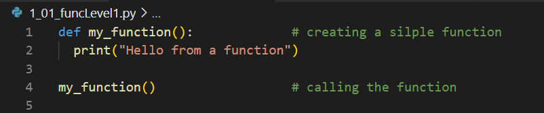
Creating and using functions
Functions – level 1
Level 1 : basic function without any parameter

Slide 7
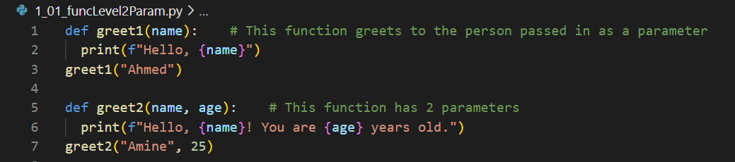
Creating and using functions
Functions – level 2
Level 2 : function with parameters

Slide 8
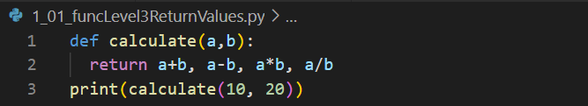
Creating and using functions
Functions – level 3
Level 3 : return one or more values

Slide 9
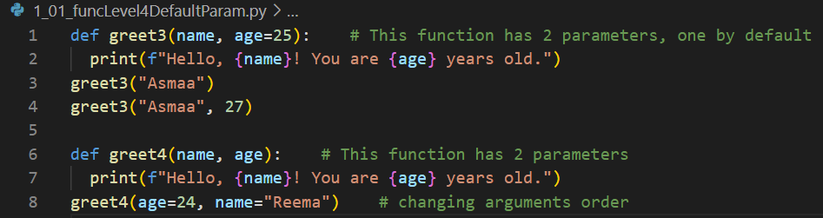
Creating and using functions
Functions – level 4
Level 4 : default parameter values, parameter order

Slide 10
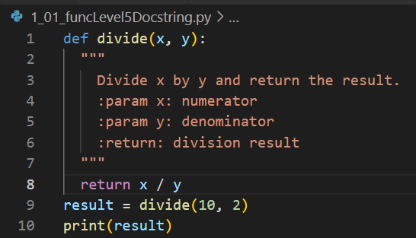
Creating and using functions
Functions – level 5
Level 5 : docstring

Slide 11
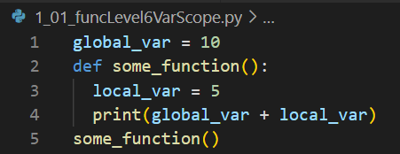
Creating and using functions
Functions – level 6
Level 6 : variable scope

Slide 12
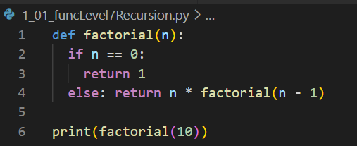
Creating and using functions
Functions – level 7
Level 7 : recursion

Slide 13
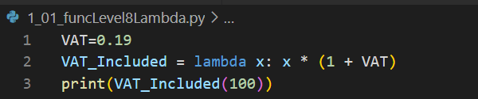
Creating and using functions
Functions – level 8
Level 8 : Lambda

Slide 14
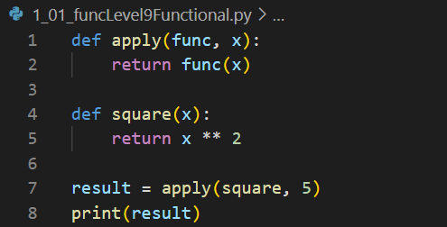
Creating and using functions
Functions – level 9
Level 9 : functional

Slide 15
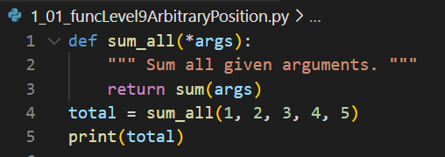
Creating and using functions
Functions – level 9
Level 9 : Arbitrary positional parameters

Slide 16
Creating and using functions
Functions – level 10
Level 10 : functional

Slide 17
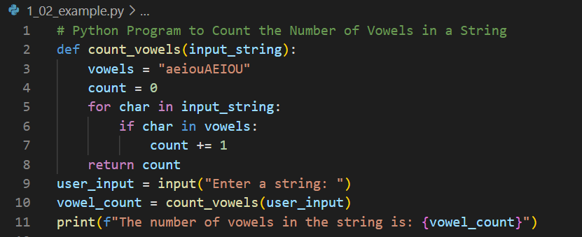
Creating and using functions
Functions – practice Example
Python Program to Count the Number of Vowels in a String

Slide 18
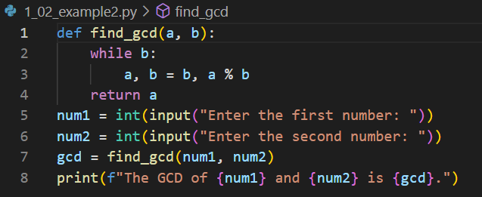
Creating and using functions
Functions – practice Example
Python Program to Find the GCD of Two Numbers

Slide 19
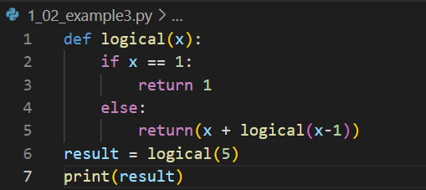
Creating and using functions
Functions – practice Example
Logical of a number

Slide 20
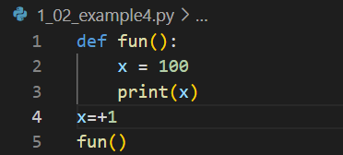
Creating and using functions
Functions – practice Example
Scope

Slide 21
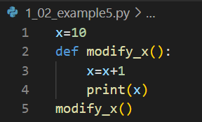
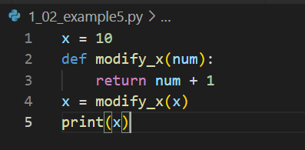
Creating and using functions
Functions – practice Example
Scope

Slide 22
Creating and using functions
Functions – practice Example
Scope

Slide 23
3. Mutable & immutable data types 1.1. mutable 1.2. immutables

Slide 24
4. Exception & Error handling 1.1. Lists 1.2. Tuples 1.3. Dictionnaries 1.4. Sets 1.5. Generators

Slide 25
2. File handling in Python

Slide 26
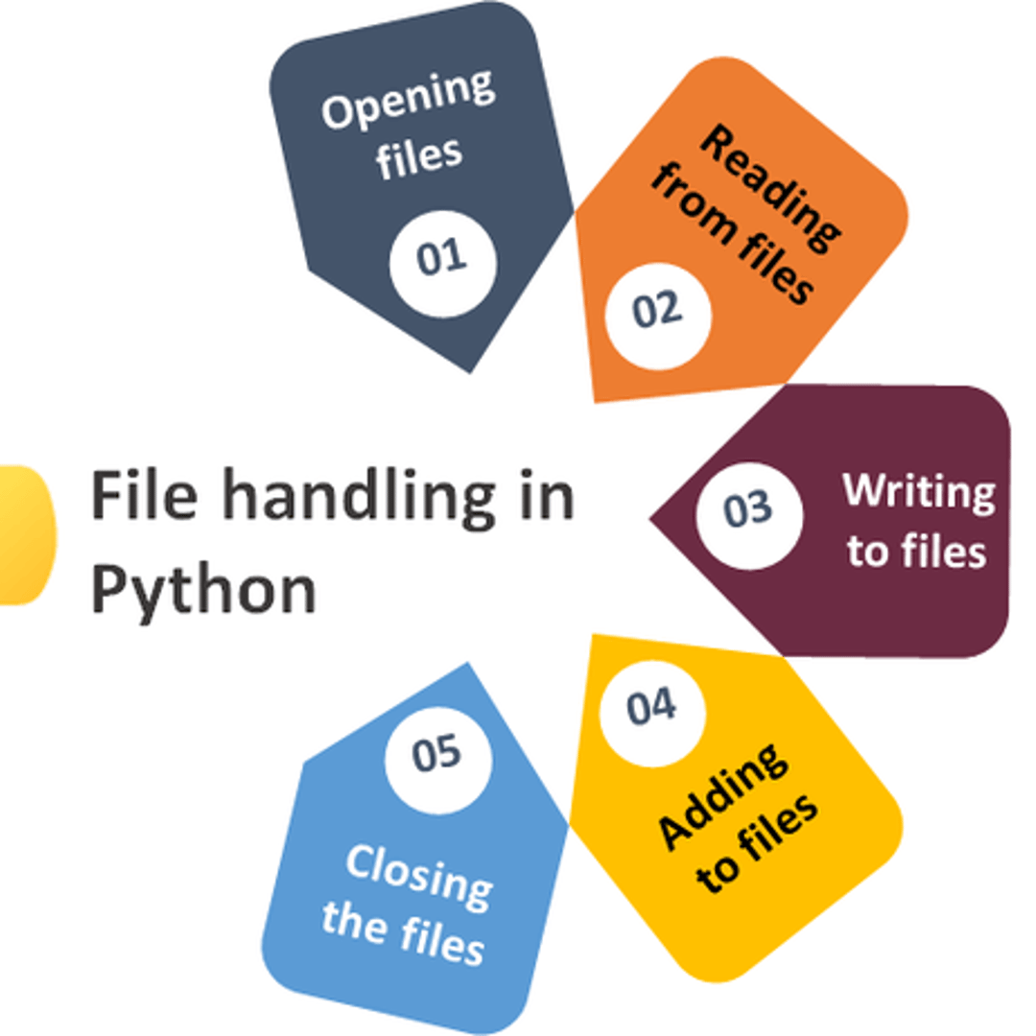
File handling in Python
Overview 1/2
File handling is an important part of any application.
Python has several functions for creating, reading, updating, and deleting files.
تعد معالجة الملفات جزءًا مهمًا من أي تطبيق.
لدىPython العديد من الدوال لإنشاء الملفات وقراءتها وتحديثها وحذفها.
https://www.w3schools.com/python/python_file_handling.asp

Slide 27
The key function for working with files in Python is the open() function. The open() function takes two parameters; filename, and mode. There are four different methods (modes) for opening a file:
File handling in Python
Overview 2/2
"r" - Read - Default value. Opens a file for reading, error if the file does not exist
"a" - Append - Opens a file for appending, creates the file if it does not exist
"w" - Write - Opens a file for writing, creates the file if it does not exist
"x" - Create - Creates the specified file, returns an error if the file exists
In addition, you can specify if the file should be handled as binary or text mode
"t" - Text - Default value. Text mode
"b" - Binary - Binary mode (e.g. images)
Abdesselam Filali 2024-04-17

Slide 28
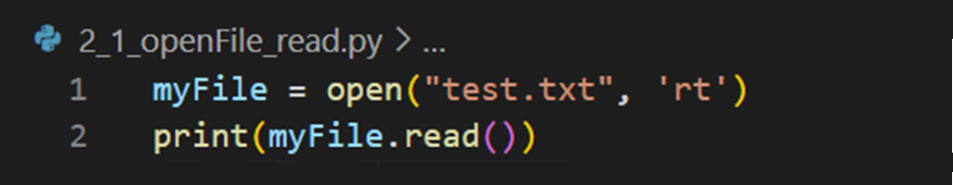
File handling in Python
Open and read a file
Filename
Mode
Reading Method
"test.txt"
"rt"
read()
Code:
Because "r" for read and "t" for text are the default values, you don’t need to specify them.

Slide 29
File handling in Python
Practical Exercise: Read a file
Read a file:
The file is in the same directory
The file is in a different directory
The file doesn’t exist
Read and print it on screen
Programming Language

Slide 30

Complete path
File handling in Python
Practical Exercise: Read a file
Code:
Slash instead of back slash

Slide 31
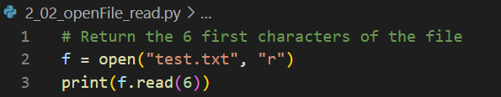
Read part of a file
File handling in Python
Practical Exercise: Read a file
Filename
Mode
Reading Method
"test.txt"
"rt"
Read(n)
Code:

Slide 32
File handling in Python
Practical Exercise: Read an image file
Read an image file
Al-Aqsa.jpg (in the same directory)
Binary file
Read and print it on screen
Show the image
Remove the background (library)
Programming Language

Slide 33
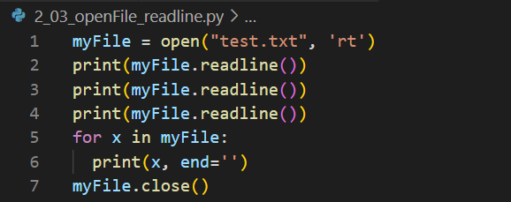
Read part of a file (lines)
File handling in Python
Example
Filename
Mode
Reading Method
"test.txt"
"rt"
Readline(n)
Code:

Slide 34
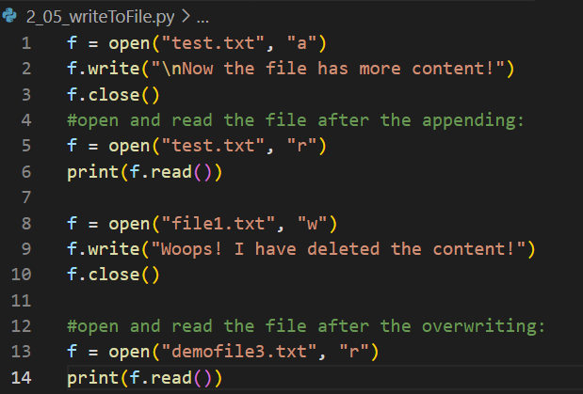
To write to an existing file, you must add a parameter to the open() function: "a" - Append - will append to the end of the file "w" - Write - will overwrite any existing content
File handling in Python
Create a file
Code:

Slide 35

To create a file, you must add a parameter to the open() function: "x" - Create a new file "w" - Create a new file id it doesn’t exist
File handling in Python
Create a file
Code:

Slide 36
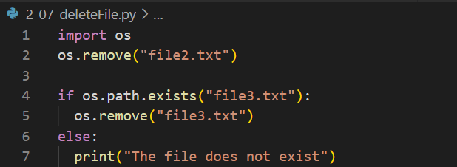
To delete a file, you must use the os library os.remove(file.txt) - Remove a file os.rmdir(folder1) - Remove a directory, you can only delete an empty one
File handling in Python
Delete a file
Code:

Slide 37
Writing to a file
File handling in Python
Example
File handling in Python
Filename
Mode
Reading Method
"test.txt"
"rt"
read()
Code:

Slide 38
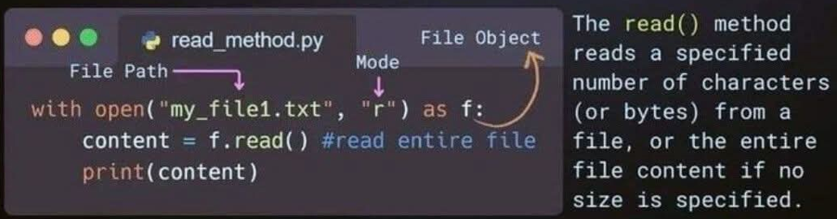
File handling in Python
Tips reading a file
Programming Language

Slide 39
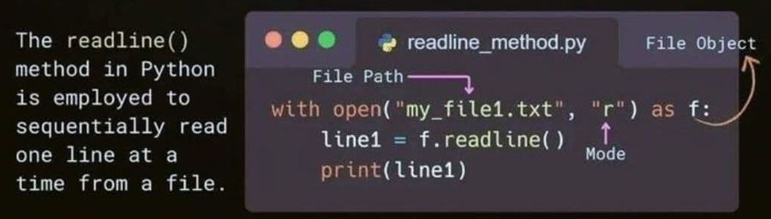
File handling in Python
Tips reading a file
Programming Language

Slide 40
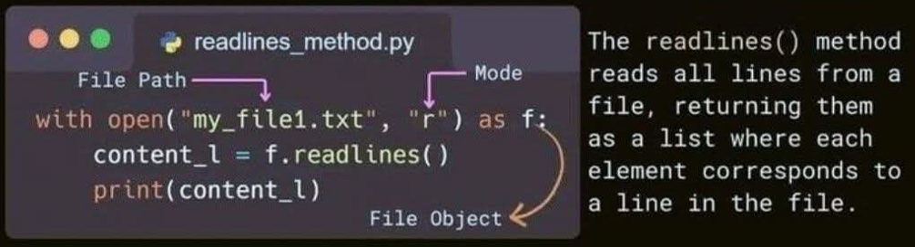
File handling in Python
Tips reading a file
Programming Language

Slide 41
4. NumPy Library

Slide 42

1.

Slide 43

What is NumPy? NumPy (Numerical Python) is a fundamental powerful library for mathematical and numerical operations. It provides support for large, multi-dimensional arrays and matrices, along with a wide range of mathematical functions to operate on these arrays efficiently. Why use NumPy? - Much faster than Python lists for numerical tasks - Used as the foundation for libraries like Pandas, TensorFlow, and Scikit-learn - Makes matrix operations, statistics, and data transformations easy and efficient installation pip install numpy
Exceptions and error handling
NumPy Library
https://www.w3schools.com/python/numpy/default.asp

Slide 44
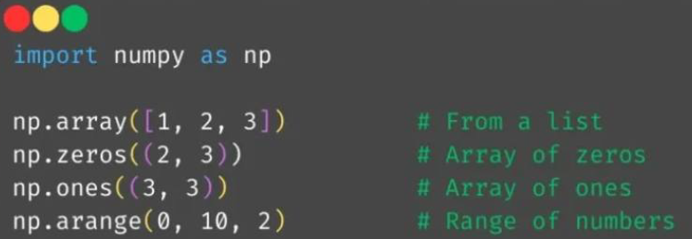
What is NumPy Array? A NumPy array is a powerful data structure that stores elements of the same data type in a grid-like format. It’s much faster and more efficient than Python lists for numerical operations.. Creating Arrays:
Exceptions and error handling
NumPy Library
https://www.w3schools.com/python/numpy/default.asp

Slide 45
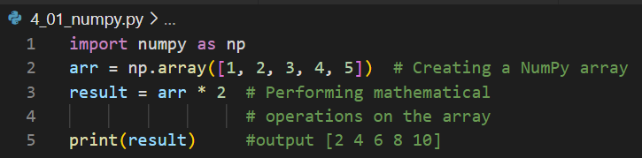
Creating Array: Code:
Exceptions and error handling
NumPy Library
https://www.w3schools.com/python/numpy/default.asp

Slide 46
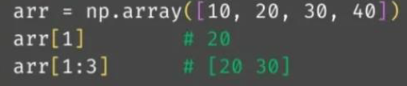
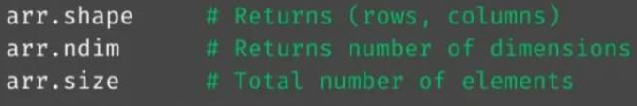

Basic Array Operations: Indexing and slicing: Array Shape & Dimensions: Reshaping Arrays: Reshaping Arrays:
Exceptions and error handling
NumPy Library
https://www.w3schools.com/python/numpy/default.asp

Slide 47
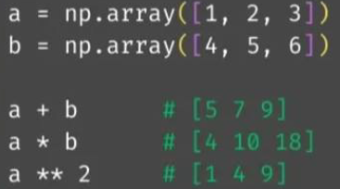
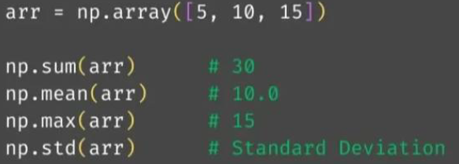
Mathematical Operations: Element-Wise operations: Aggregate functions: Reshaping Arrays:
Exceptions and error handling
NumPy Library
https://www.w3schools.com/python/numpy/default.asp

Slide 48
Mathematical Operations: Element-Wise operations: Aggregate functions: NumPy makes math easy — no need for loops! Just write it once and it works on the entire array.
Exceptions and error handling
NumPy Library
https://www.w3schools.com/python/numpy/default.asp

Slide 49
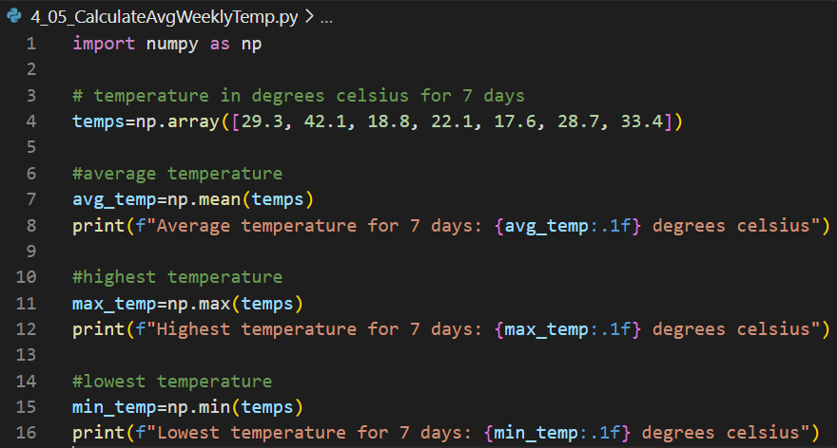
Let’s use NumPy in a real-world scenario: analyzing temperature data! Example: Calculate Average Weekly Temperature
Exceptions and error handling
Example using NumPy
https://www.w3schools.com/python/numpy/default.asp

Slide 50
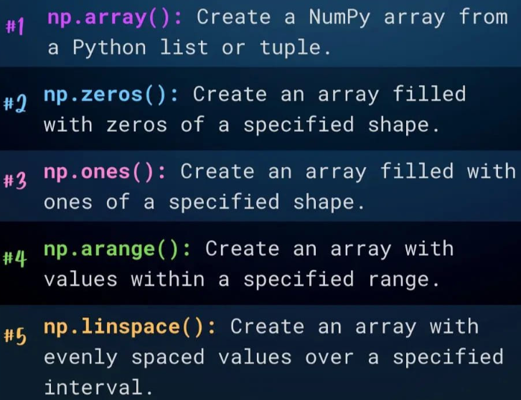

Slide 51
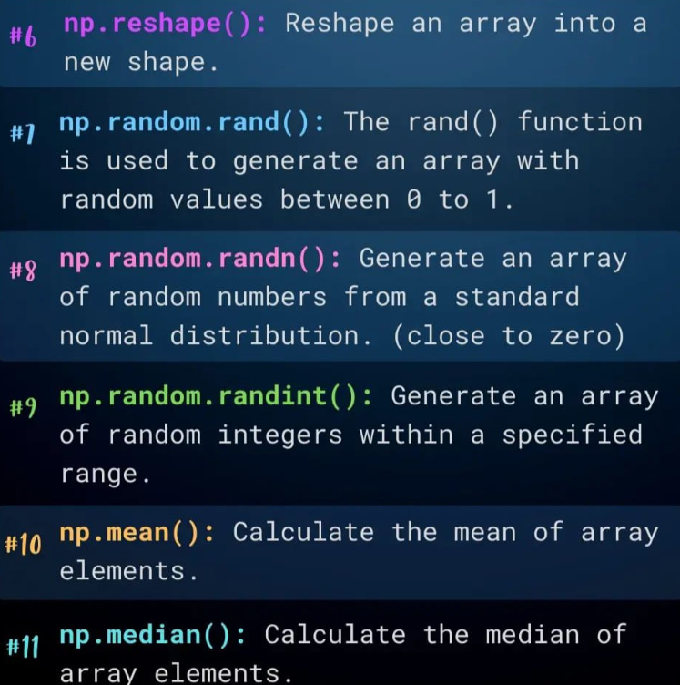

Slide 52
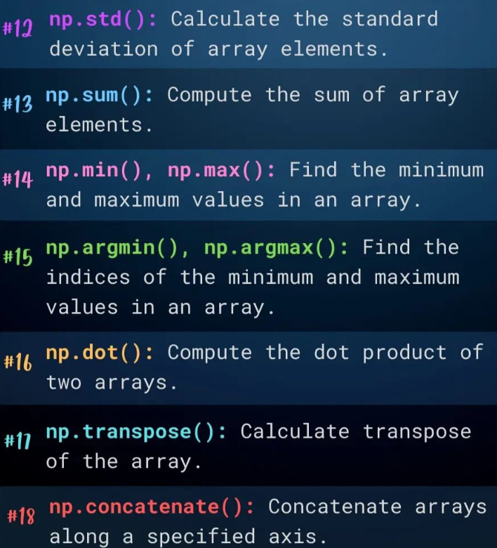

Slide 53
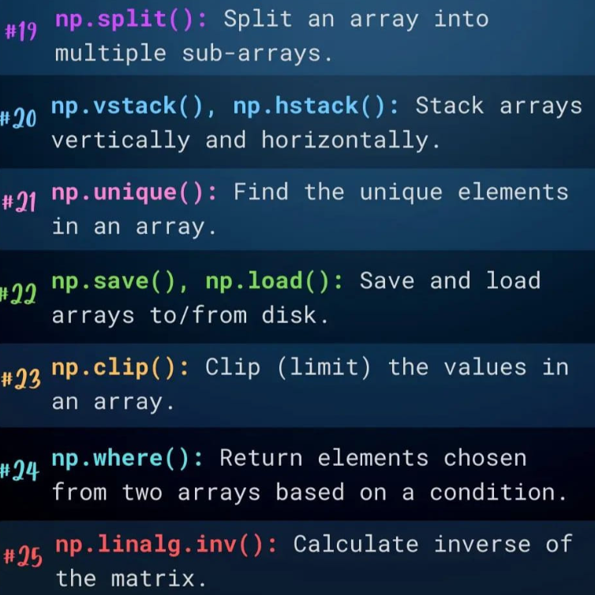

Slide 54
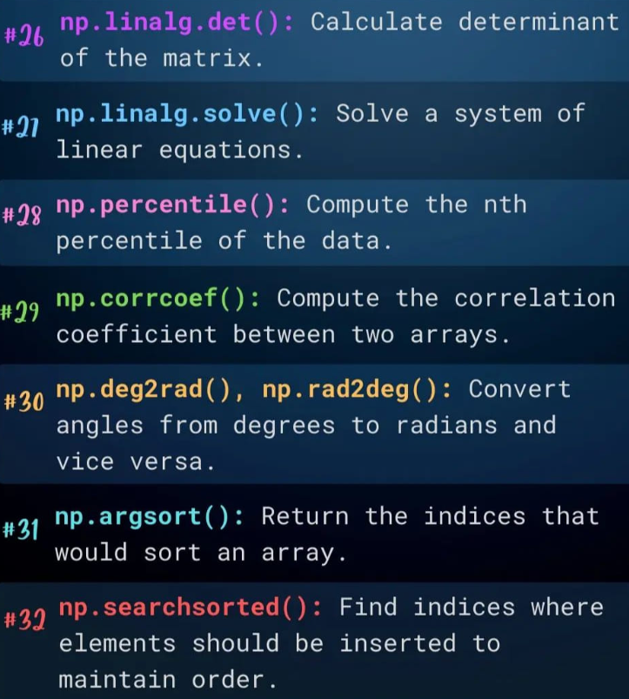

Slide 55
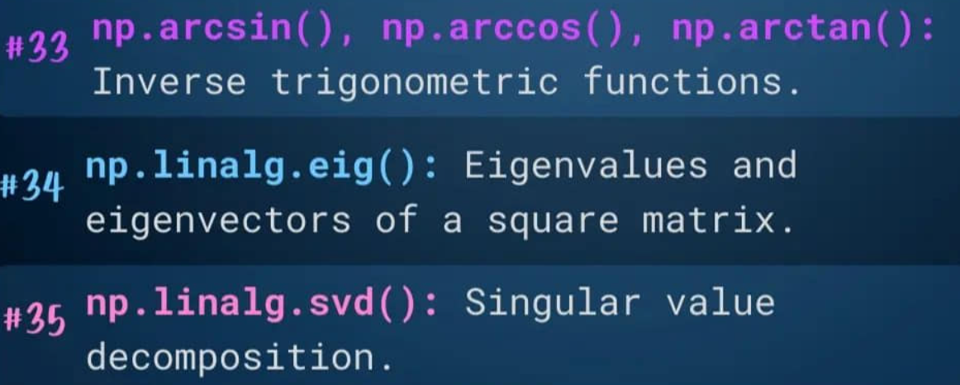

Slide 56
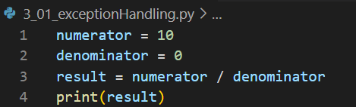
ZeroDivisionError is raised when a program attempts to perform a division operation where the denominator is zero. Syntax: ZeroDivisionError: division by zero Why : Direct Division by Zero
Exceptions and error handling
Exception handling 1/4
Code:

Slide 57
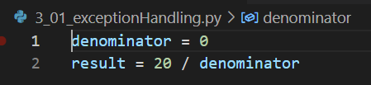
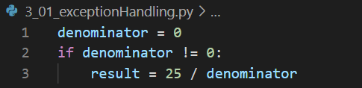
Why : Variable Initialization Issue Why : Conditional Statements Issue
Exceptions and error handling
Exception handling 2/4
Code:
Code:

Slide 58
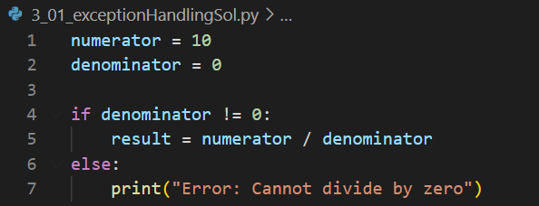
Approach/Reason to Solve Zerodivisionerror Use if-else
Exceptions and error handling
Exception handling 3/4
Code:

Slide 59
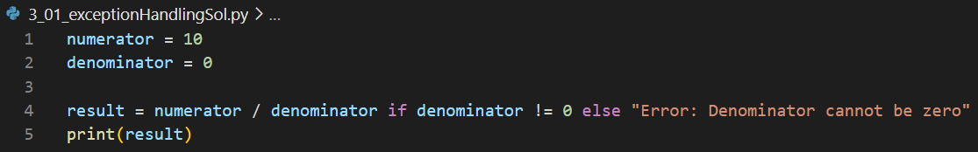
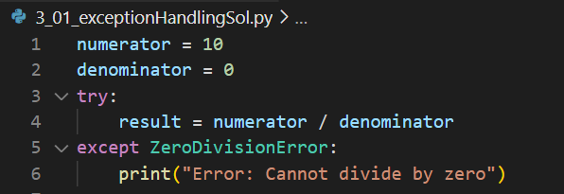
Using Conditional Expression Catching the Exception (Using Try-Except Block)
Exceptions and error handling
Exception handling 4/4

Slide 60
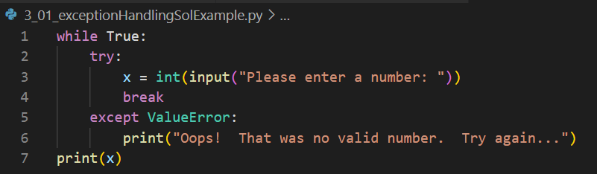
Input a valid number
Exceptions and error handling
Practical example

Slide 61
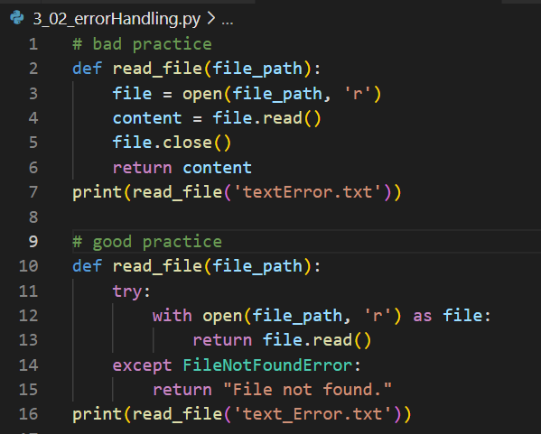
Exceptions and error handling
Error handling
Code:

